Slide 1


FOODLINK: CONNECTING SURPLUS TO SUSTENANCE
Sustainable Development Goals 2 and 12
Presented by: BOOLEAN HOOLIGANS 2 - ON206

Slide 2

Boolean Hooligans 2
Background of the Study | 3
Problem Statement | 4
Architectural Framework | 5
Proposed Solution | 6
Implementation | 7
Working | 8
Team | 10
AGENDA

Slide 3

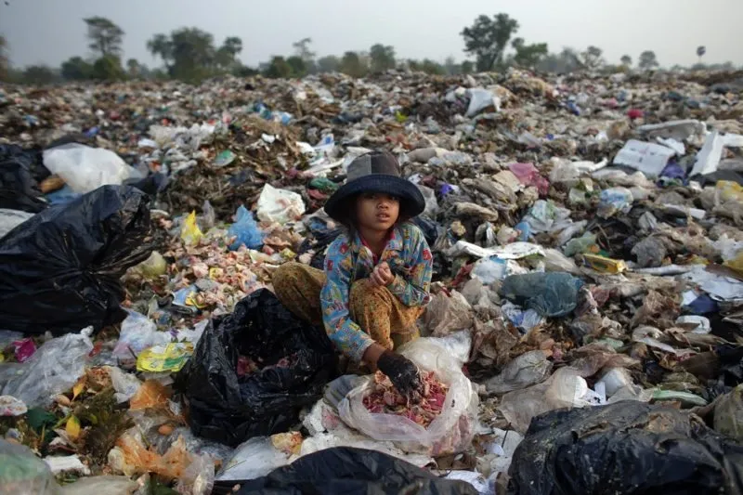

Boolean Hooligans 2
BACKGROUND
Addressing the dual challenges of food waste and hunger disparities in urban areas by constructing a bridge that efficiently channels surplus food to those in need, thereby combating food waste and ensuring equitable access to nutritious meals.

Slide 4
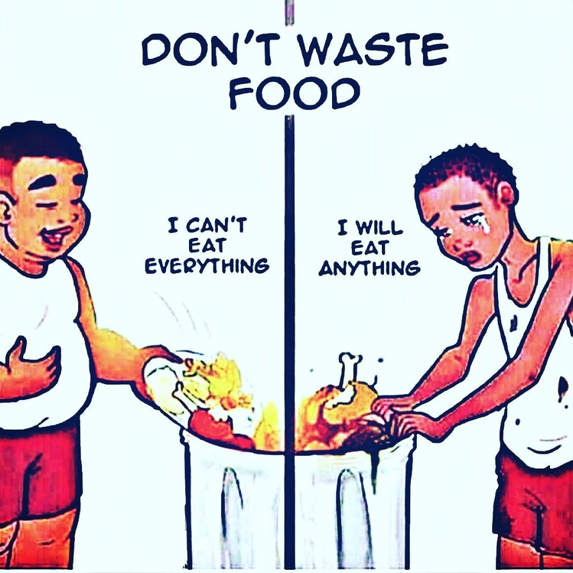

Boolean Hooligans 2
SCOPE OF THE PROJECT | Our project seeks to create a user-friendly web app connecting surplus food providers, like restaurants and grocery stores, with local food banks. This solution efficiently redirects surplus food to reduce waste and improve food access in underserved urban communities.
RELEVANCE OF THE PROJECT | Our project aligns with the United Nations Sustainable Development Goals (SDGs), specifically Goal 2 (Zero Hunger) and Goal 12 (Responsible Consumption and Production). By addressing food waste and hunger disparities, we contribute to the achievement of these global objectives. It promotes food equity and social justice in urban environments. Our solution can minimize the carbon footprint associated with food production and disposal, contributing to a more sustainable urban environment.
RESEARCH QUESTION | How can the development and implementation of a user-friendly web app facilitate the efficient redistribution of surplus food in urban areas, effectively reducing food waste and hunger disparities, while aligning with Sustainable Development Goals 2 and 12?
Problem
Statement

Slide 5


Boolean Hooligans 2
Access Google API
Retrieve Data In Nearby Shelters
Clean and prepare shelter Data
METHODOLOGY
Fetch Shelter Information from Google API
Data Preprocessing
Allocate food to Shelters
Distribution Optimization (by pattern recognition)
Find Matching Shelter
Check Shelter Location and Capacity
AI Prediction Model
Optimize Distribution
Match Making
Predicting Demand
Wait for shelter Confirmation
Yes ----> Record donation
No ----> Notify Other Shelter
Gather info on Food Quantity
Food Quality
Food Wastage, excess etc
Notify Matched Shelter
Notify
Donation Confirmation
Update FeedBack

Slide 6

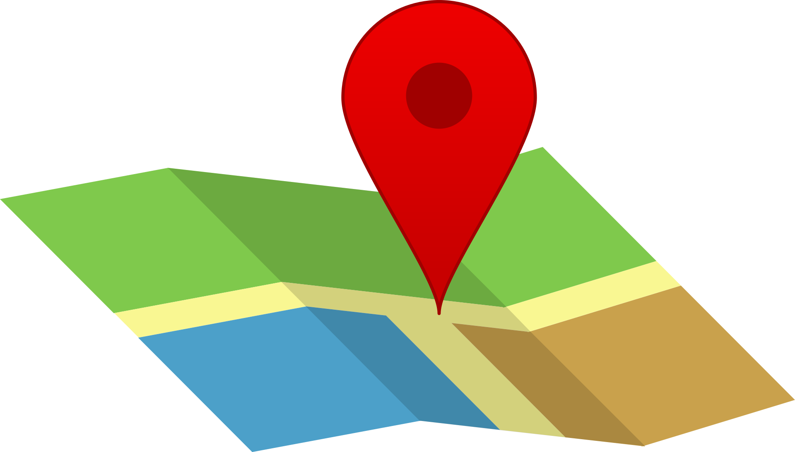

Boolean Hooligans 2
TECHNOLOGY STACK
Google maps

Slide 7
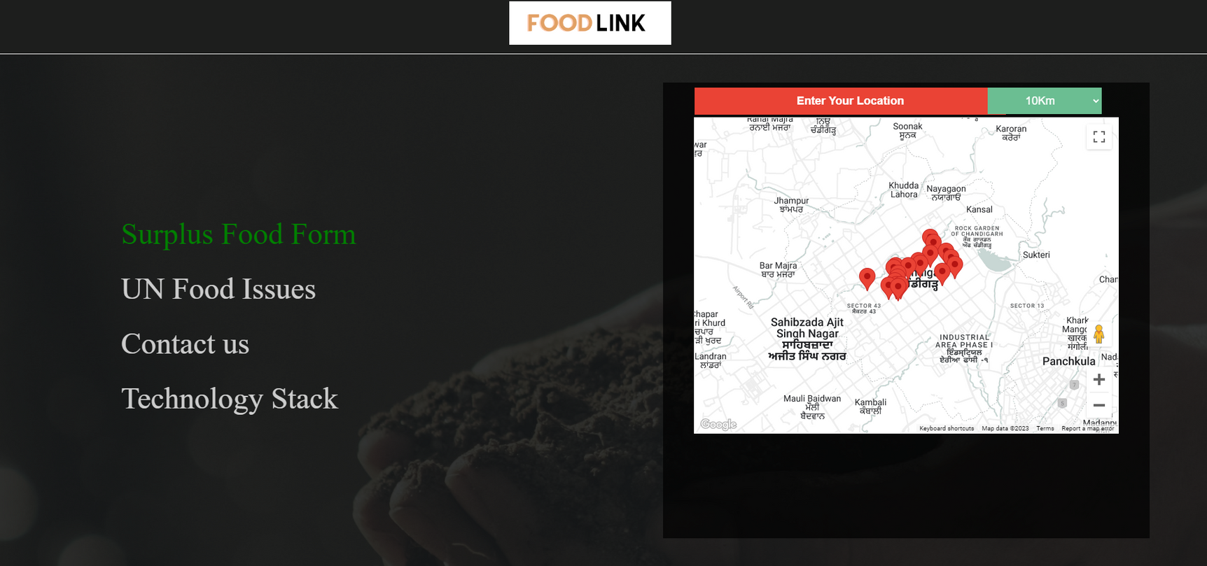
Boolean Hooligans 2
WORKING - WEB APP

Slide 8

IBM-Z ROLE
In our project, we harnessed the power of IBM z-series mainframes to address our computer's limitations in multi-processing and lack of communication between systems. By leveraging the z-series' robust parallel computing capabilities, we significantly improved our project's performance and scalability, enabling efficient data processing and analytics.

